Slide 1
PB&J
Abigail Francis
Jonathan Hawkins
Brandon Lipjanic
Pierce Simpson

Slide 2
Overview
Requirements Approach (A high-level description of your whole approach) Hardware Software Deliverables/Conclusion

Slide 3
Requirements

Slide 4
Requirements
Part 1:
The robot shall follow a black tape line.
Part 2:
The robot shall detect obstacles impeding its forward path.
Part 3:
The robot shall earn points by following the track whilst avoiding collisions.

Slide 5
Approach

Slide 6
Approach: Overview
Our strategy is to keep getting the most points we can by following the large triangles and avoiding robots which are on our path.

Slide 7
Approach: IR Sensors
8 or more IR sensors:
>Line following
>Intersection analysis

Slide 8
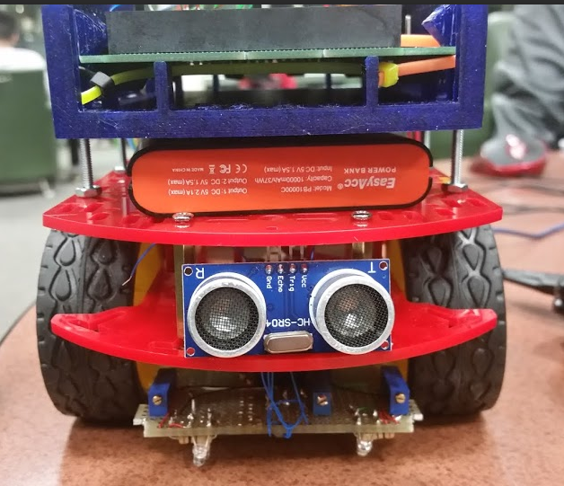
Approach: Ultrasonic Distance Sensor
Front ultrasonic distance sensor:
>Detect obstacle presence when at a node
>Detect obstacle movement direction

Slide 9
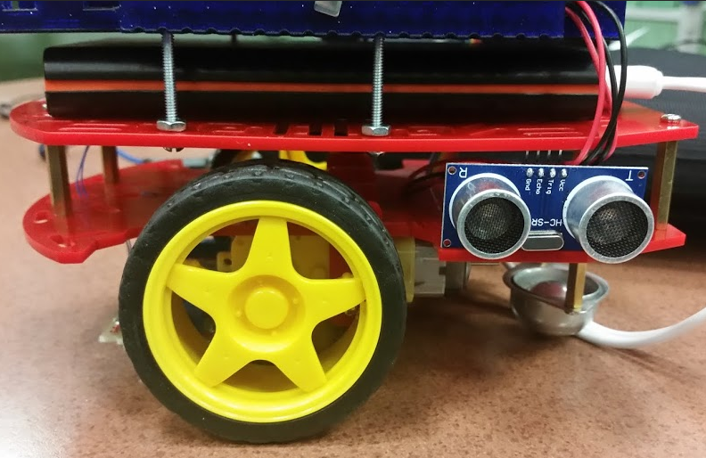
Approach: Ultrasonic Distance Sensor
Side ultrasonic distance sensor:
>Detect obstacle presence when passing obstacle

Slide 10
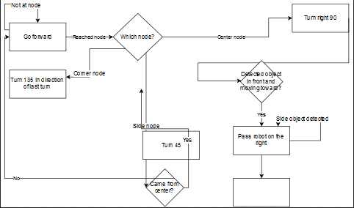
Approach: Software

Slide 11
Hardware

Slide 12
Hardware
IR Sensors
Ultrasonic Distance Sensor
Motor Control
Protective Cover
PIC Stand

Slide 13
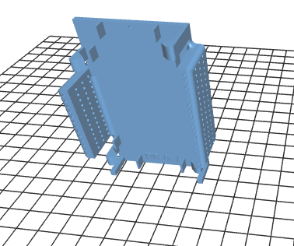
Hardware: PIC Stand
3D printed holster for development board
> stability of development board
> easy peripheral attachment
> Connection protection

Slide 14
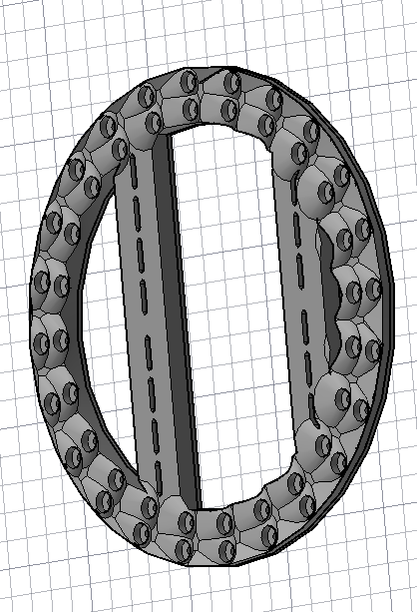
Hardware: PIC Skirt
PIC Skirt:
> Protection for turn radius
>Easy peripheral attatchments

Slide 15
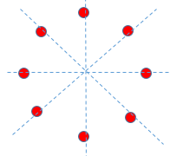
Hardware: IR Sensors
IR Sensor Configuration:
>Circular for maximizing node type recognition
>determines positon better than 4 sensor configuration

Slide 16
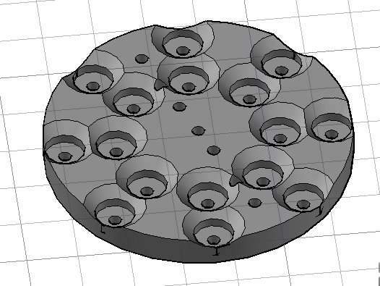
Hardware: IR Sensors
IR Sensor casing:
>3D printed IR sensor case
>Standard spacing and height

Slide 17
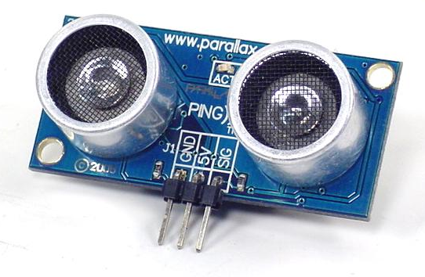
Hardware: Ultrasonic Distance Sensor
Ultrasonic Distance Sensor:
>Detect obstacle presence
>Detect direction of movement

Slide 18
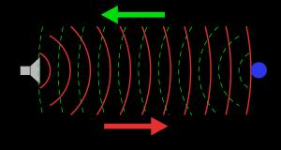
Hardware: Ultrasonic Distance Sensor
Works like a bat

Slide 19
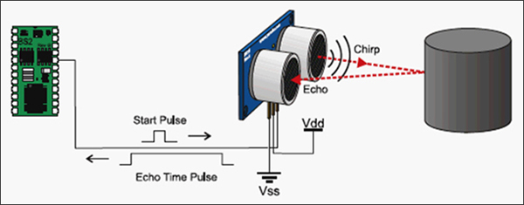
Hardware: Ultrasonic Distance Sensor

Slide 20
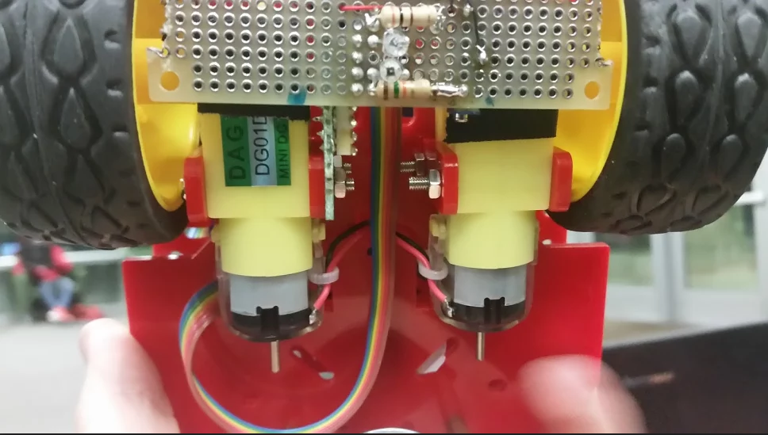
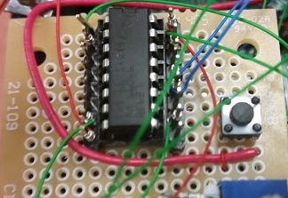
Hardware: Motor Control
Motor Control:
>amplifier connects 2 motors to PIC
>Motors can be controlled independently
>Motors can go forward and backward

Slide 21
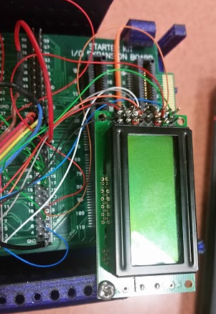
Hardware: LCD Screen
LCD Screen:
>Debuggiing purposes
>Displays state of each IR sensor
>Displays corresponding command

Slide 22
Software

Slide 23
Software
Emphasis on modular design
Obstacle avoidance
Location awareness

Slide 24
Software: Modular design
3 state machines:
>The primary state machine
>Two secondary state machines
Find Line State Machine
Obstacle Avoidance State Machine
>Use of LCD

Slide 25
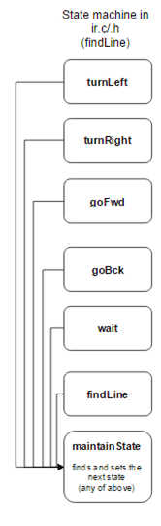
Software: Modular design
Find Line State Machine:
>Controls the robot
>States Based on actions

Slide 26
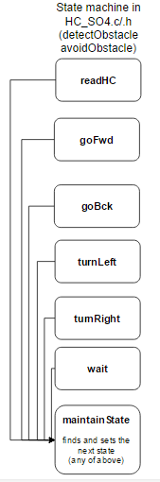
Software: Modular design
Obstacle Avoidance State Machine:
>Controls the robot based on the status of the distance sensor.
>If an object is found while scanning a potential line it will return to the find line state machine to find a new line.

Slide 27
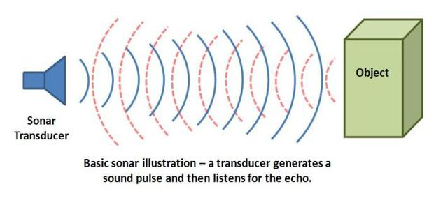
Software: Obstacle avoidance
Range Sensor:
>Used to detect obstacles
>Obstacle avoidance
state machine
>Sensor Limits

Slide 28
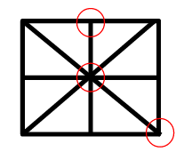
Software: Location Awareness
Location awareness features:
>Detect map features
>React to map features

Slide 29
Deliverables

Slide 30
Deliverables
Deliverables:
>Example Code for using the HC- SRO4 sensor
>AUTOCAD files for board housing

Slide 31
Conclusion

Slide 32
Conclusion
>Our goal is to earn points by traversing the track and avoiding other robots
>It is achievable due to the ease of implementation and testing due to our modular design
>Thank you for listening!

Slide 33
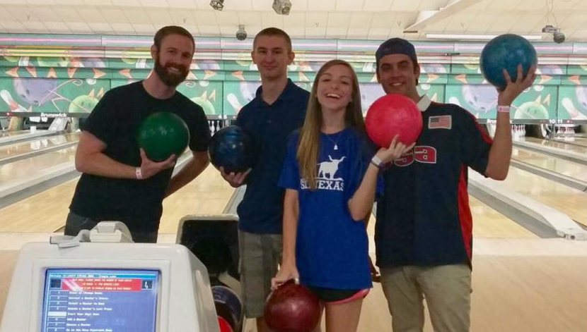
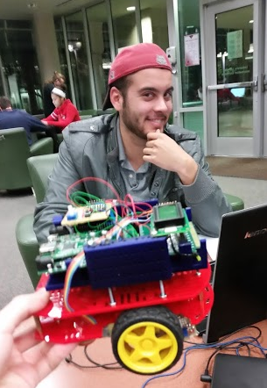
PEANUT
JELLY
IERCE
BUTTER
ONATHAN
AND
RANDON
BIGAIL

